Slide 1
Centralized Model Registry
Luis Moros - Solutions Architect
Daniel Perez - Customer Success Engineer

Slide 2
BACKGROUND

Slide 3



Background
A tool for customers that heavily rely on MLFlow for building and managing models.
Sharing models across multiple workspaces is useful for:
Customers with multiple teams that share access to models
Customers with multiple workspaces to handle the different stages of development.

Slide 4
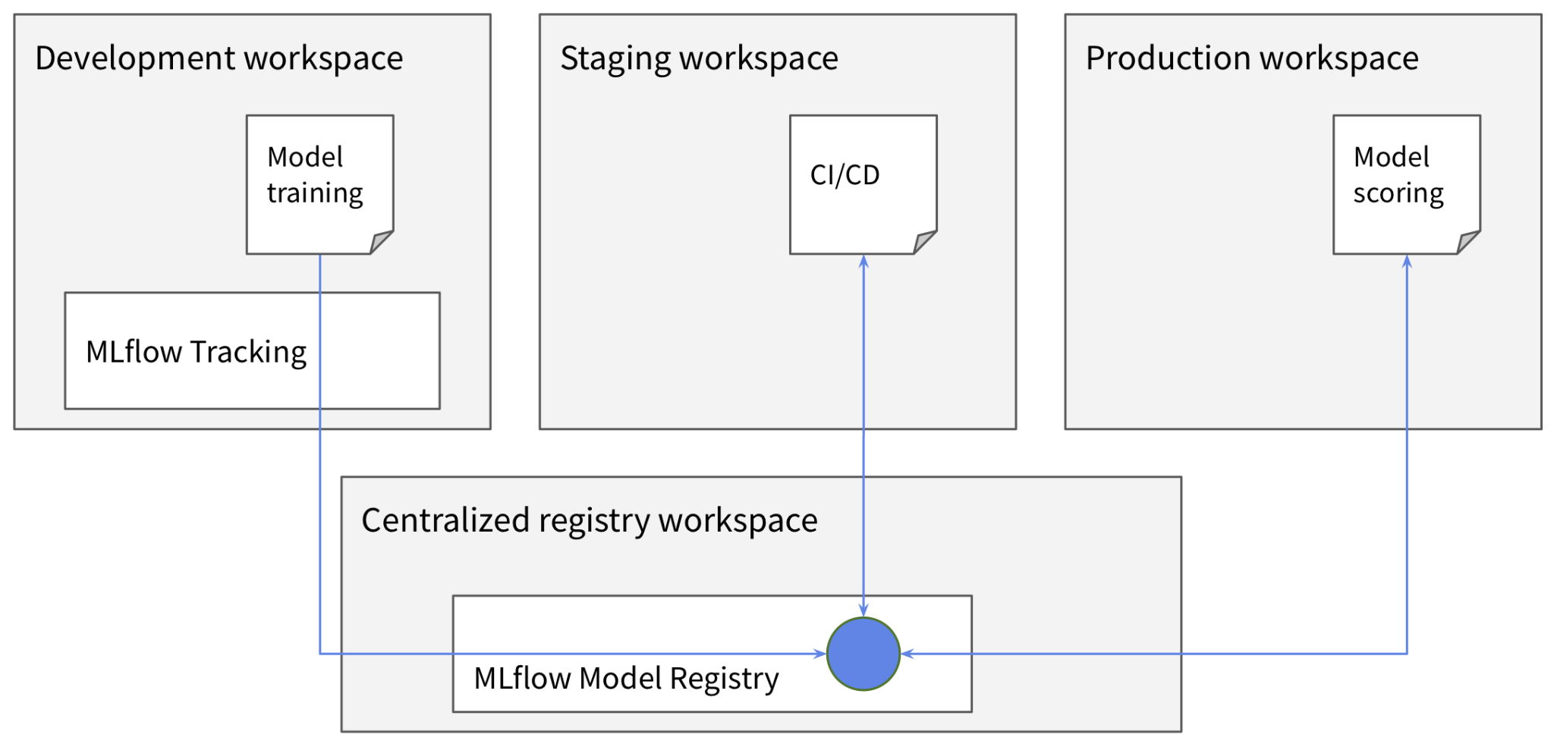
General Architecture

Slide 5
General Architecture
Central Workspace

Slide 6
General Architecture
Satellite Workspaces

Slide 7
MODEL FLOW

Slide 8
Model Flow
Data Scientist
1
Model version:
Created
Registered
Requested transition to stage phase

Slide 9

Model Flow
2
Model version:
Transitioned to stage phase

Slide 10
Model Flow
QA Engineer
3
Model version:
Downloaded from stage phase
Tested

Slide 11
Model Flow
QA Engineer
4
Model version:
Requested transition to production phase

Slide 12

Model Flow
Production Functional Account
5
Model version:
Downloaded from prod phase
Deployed

Slide 13
Model Flow
3
1
Model version:
Downloaded from stage phase
Tested
Model version:
Created
Registered
Requested transition to stage phase
5
Model version:
Downloaded from prod phase
Deployed
2
4
Model version:
Transitioned to stage phase
Model version:
Requested transition to production phase

Slide 14
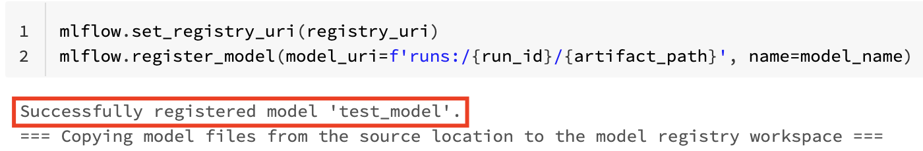
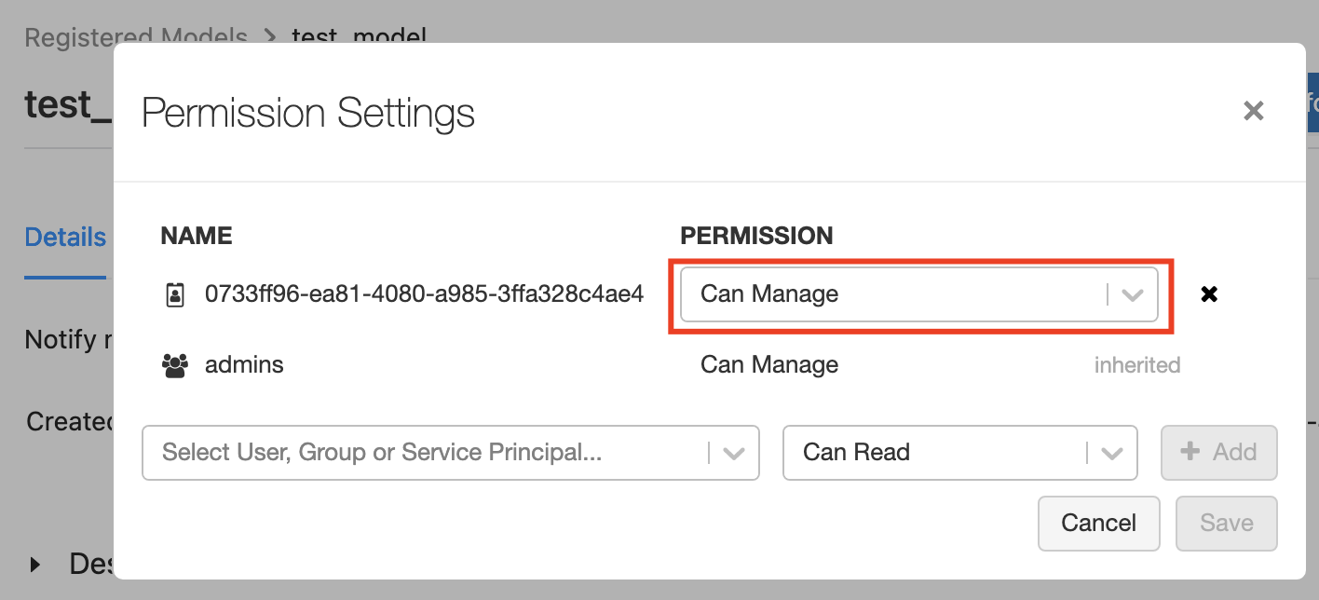
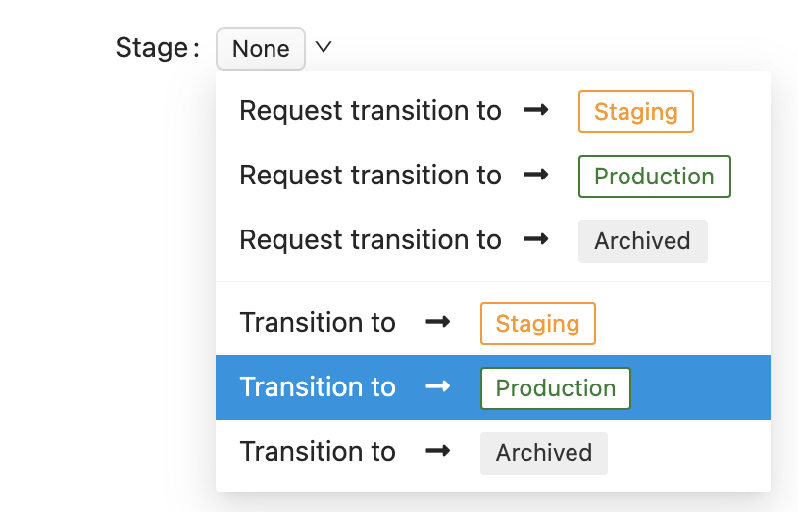
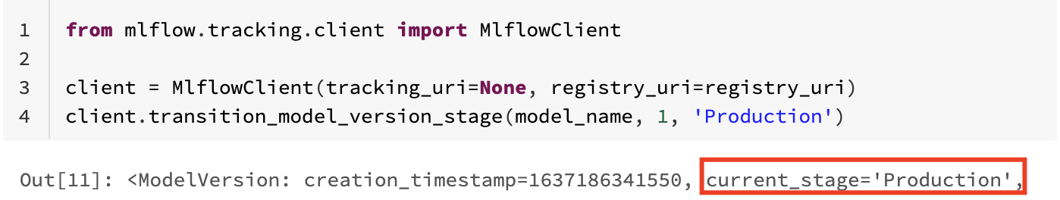
Situation
The current version of the Centralized Model Registry automatically gives Owner permissions to whomever registers a model to it.
This allows for the same persona that registers the model to also be able to transition the model to Production - bypassing any quality checking.
Product is aware of this shortcoming and evaluating potential fixes.

Slide 15
Model Flow

Slide 16
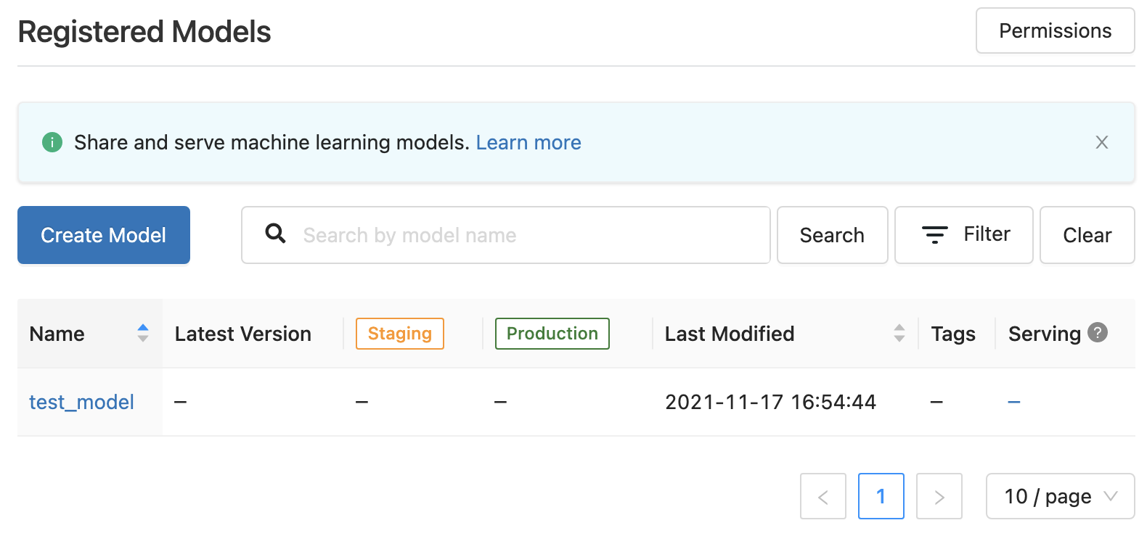

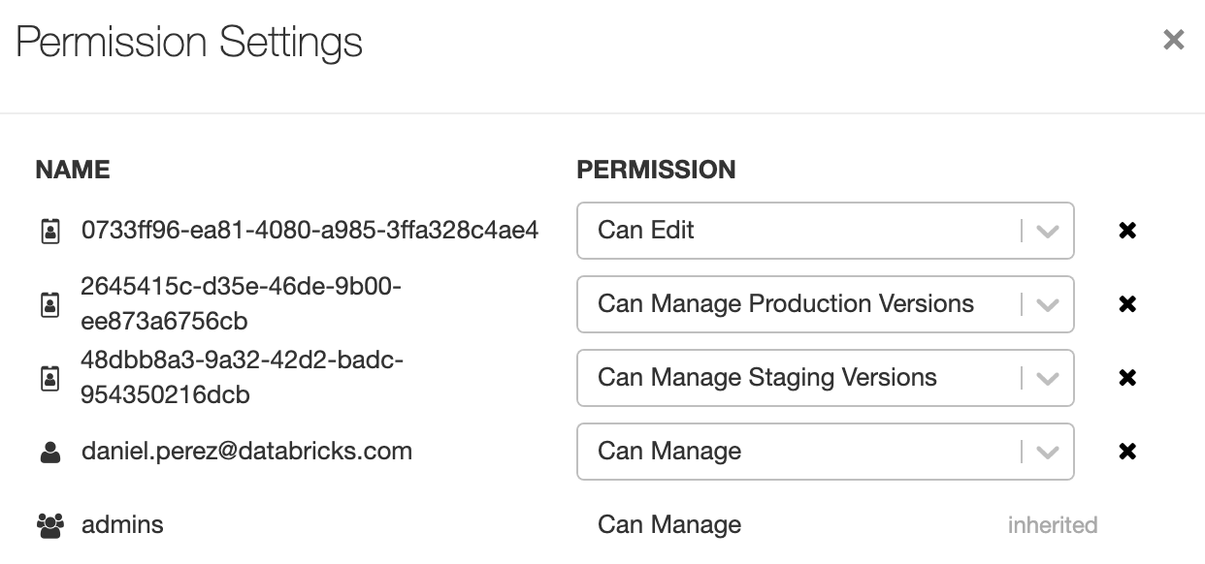
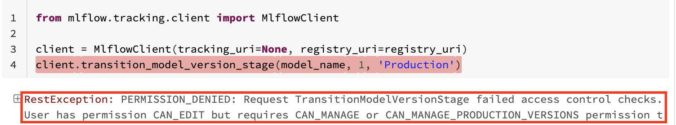
Solution
The solution for this is to:
Have an Admin register an empty “shell” of a Model in the Central Model Registry, and assign the proper permissions to the right personas.
Data Scientist
ML Engineer
QA Engineer
Admin

Slide 17
Personas
Data Scientist
QA Engineer
Production Functional Account
Admin

Slide 18
Detailed Model Flow
Data Scientist (SP):
Creates the Model in their Dev workspace
Creates the Test Notebook in the Dev workspace
Creates the Scoring Notebook in the Dev workspace
Registers the new Model version from Dev workspace to the Central Registry (MLFLow API)
Requests Transition of the new Model from Dev workspace version to Staging phase at the Central Registry (MLFLow API)
Manages the deployment procedure of the Test and Scoring notebooks.
QA Engineer (SP):
Executes the test notebook in the Staging workspace which:
Downloads the Model from Central Registry to the Staging workspace (MLFLow API)
Executes the admin notebook in the Staging workspace which:
Requests Transition of the new Model from Staging phase version to Production phase at the Central Registry (MLFLow API)
Production (SP):
Executes the scoring notebook in the Production workspace which:
Downloads the Model from Central Registry to the Production workspace (MLFLow API)
Admin:
Registers an empty Model in the Central Registry (Workspace).
Assigns permissions to the other SPs in the Central Registry (Workspace).
Accepts model transitions in the Central Registry (Workspace).
Dev->Stage
Stage->Production

Slide 19
IMPLEMENTATION

Slide 20

Create Service Principals and Client Secrets
on Azure
Staging
Service Principal
Development
Service Principal
Production
Service Principal

Slide 21
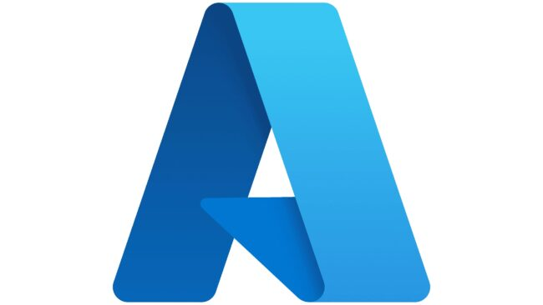
Create Service Principals and Client Secrets
on Azure
Create Service Principal (App Registration)
Documentation
Create Client Secret
Documentation
Note: Note down the Tenant, Client ID and Client Secret

Slide 22

Create PAT Token for each Service Principal in the
Central Workspace
Staging
Service Principal
Development
Service Principal
Production
Service Principal

Slide 23


Create Service Principal’s PAT Token in Azure Databricks
Add Service Principal to Databricks using SCIM
Documentation
Create PAT Token
Give Token ACLs to Service Principal using SCIM
Documentation
Create Bearer Token for REST API using SCIM
Use REST API to create Token
Documentation

Slide 24

Create Secret Scopes
Notes:
Give permissions to the groups intended to use the Model Registry

Slide 25
Add Service Principal’s PAT Token to the
Satellite Workspaces
databricks secrets put --scope <scope> --key <prefix>-token

Slide 26


Add Workspace Info to the
Satellite Workspaces
databricks secrets put --scope <scope> --key <prefix>-workspace-id
databricks secrets put --scope <scope> --key <prefix>-host

Slide 27
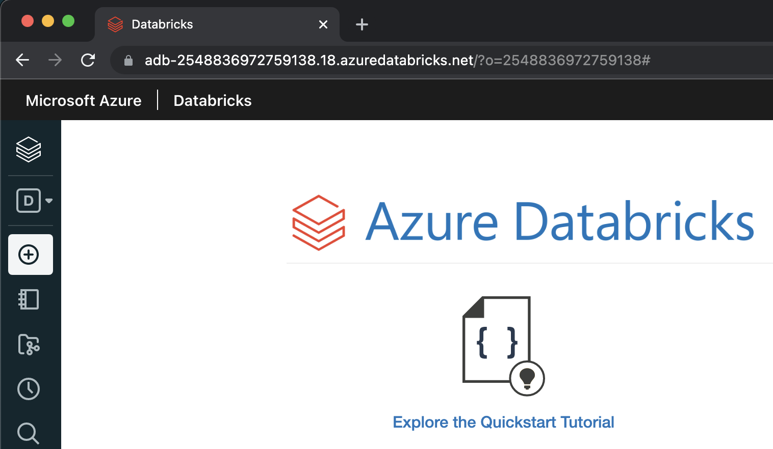
Add Workspace Info to the
Satellite Workspaces

Slide 28
Create Secret Scopes and populate with Secrets
Create Azure Key Vault-backed Secret Scopes on the corresponding Databricks Workspaces:
Documentation
Add the Secrets needed to run the Centralized Model Registry on each Databricks Workspace:
Documentation
databricks secrets put --scope <scope> --key <prefix>-token databricks secrets put --scope <scope> --key <prefix>-workspace-id
databricks secrets put --scope <scope> --key <prefix>-host

Slide 29
Satellite Workspace Secret Scope
databricks secrets put --scope <scope> --key <prefix>-token databricks secrets put --scope <scope> --key <prefix>-workspace-id
databricks secrets put --scope <scope> --key <prefix>-host
Registry URI:
registry_uri = f'databricks://<scope>:<prefix>' client = MlflowClient(tracking_uri=None, registry_uri=registry_uri)
Model Actions:
client.create_model_version(name=model_name, source=source, run_id=run_id)
client.transition_model_version_stage(model_name, version, 'Production')

Slide 30
APPENDIX

Slide 31
Relevant Documentation
Original Article: https://docs.microsoft.com/en-us/azure/databricks/applications/machine-learning/manage-model-lifecycle/multiple-workspaces
Azure Implementation Guide:
https://docs.google.com/document/d/1Tg8FwG2Gch7rL5aKTra0IEPqlhlUbJGGOiY6cUrDBwk/edit
Azure Implementation Script:
https://drive.google.com/file/d/1Z3cQBPv9sSCXP_QfVOZGEXd3O71eCdvz/view?usp=sharing

